Slide 1
Scientific Impact Evaluation for XMS
Fugang Wang
Gregor von Laszewski
Intelligent Systems Engineering Department
School of Informatics, Computing, and Engineering
Indiana University
laszewski@gmail.com
Jun 19, 2018

Slide 2
Outline
Motivation
Scientific Impact as one measure of ROI
Method for Scientific Impact Analysis
Software Architecture
Summary of Contributions to XMS
Recent achievements
Journal Publication Based Peers Comparison (updated results since the previous work)
Field Weighted Citation Impact (FWCI) analysis based on Microsoft data
Field Weighted Citation Impact
Highly Cited Papers
Future plan and Conclusion
Notes:
First a summary of past activities;
then highlights of last year’s achievements

Slide 3
Motivation
Determine scientific impact metrics based on publications to justify ROI for XSEDE based resources
XSEDE; Extended Collaborative Support Services (ECSS) within XSEDE; Individual resources
Develop a general framework that could be utilized by other resources. This could include
Have already applied similar analyses to several other virtual organizations – NCAR; Blue Waters
Other possible applications:
MRI’s
Organizations, Institutions, Departments
Telescopes, Synchrotrons, Accelerators
Notes:
We do the scientific impact analysis for XSEDE, and resources/groups within XSEDE, e.g., ECSS, Bridges;
We do this for similar organizations, e.g., NCAR, Blue Waters;
Other possible usage

Slide 4
Method for Scientific Impact Analysis
Based on bibliographic data
Papers, citations, etc.
Novel Peers Comparison Analysis
Comparison of XSEDE publications with non-XSEDE peers in the same journal
Field Weighed Citation Impact Analysis
Development of novel software framework and analysis workflow
Database mashup
RESTful services

Slide 5
Summary of Contributions to XMS
Pioneered and developed a novel software framework and analysis workflow
to obtain publication/citation data from multiple sources and create a mashup database
to generate various impact metrics and updated regularly
Web portal and RESTful services to present and communicate the results
Impact metrics and analysis results integrated with the XDMoD portal
RESTful service being utilized by XUP as part of the publication discovery service
Pioneered and integrated a comprehensive statistical analysis of the impact metrics while correlating to XSEDE entities (User; Organization; Project; Allocation; FOS)
Scientific Impact portal showing the impact metrics of XSEDE
Quarterly report as an appendix for XSEDE report to NSF
Pioneered and integrated impact analysis for other facilities utilizing the same analysis framework
E.g., Peer comparison study for ECSS publications within XSEDE, NCAR, BlueWaters, and Bridges
Notes:
Software and analysis workflow;
XD related analyses;
Analyses for others like NCAR, BlueWaters, Bridges, XD ECSS, etc.

Slide 6
Software Architecture
IU TAS
Database Mashup
IU TAS
Interface
Layer
REST API
Portal
XDMOD
Portal
IU TAS
Service
Layer
IU TAS REST Services
XSEDE
Portal
IU TAS Publications Mashup
IU TAS
Publication
Mashup
NSF Award
DB Mining
3rd Party
Queries
IU NSF Awards
Publication data
for XSEDE Users
3rd Party Data
XD Entities
Mashup
Microsoft Academic Search
Google Scholar (User profiles)
UB TAS Databases &Reports
XSEDE Databases
NSF Database
ISI Web of Science
XDMoD
Warehous
XDcDB Mirror
Publications & Accounts
XSEDE
Quarterly Reports
POPS
Proposal Data
NSF Awards
Original
Data Source
Citeseer, PUBMed, ACM, IEEE, …
Mendeley
Notes:
Layered architecture with
Data acquiring;
data curation and analysis;
service and web portal

Slide 7
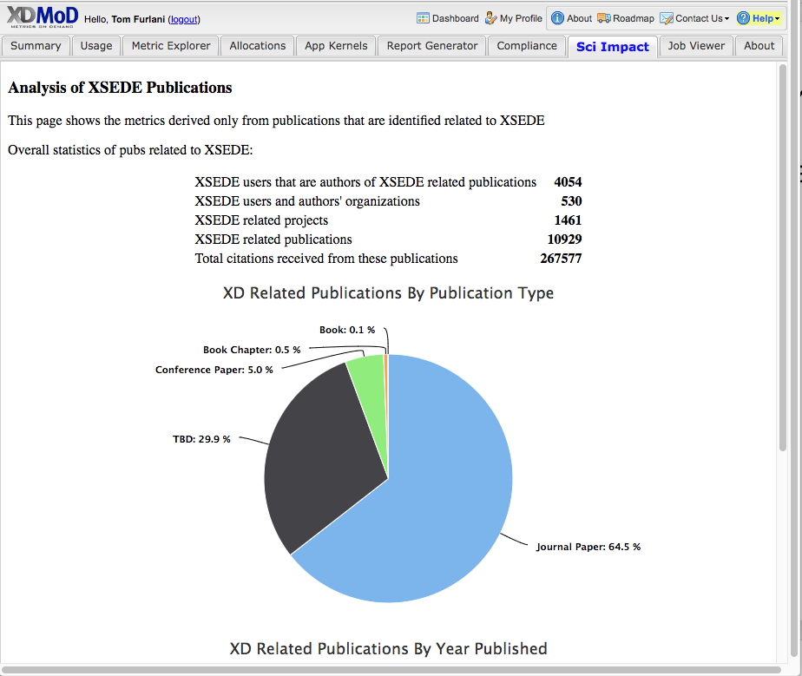
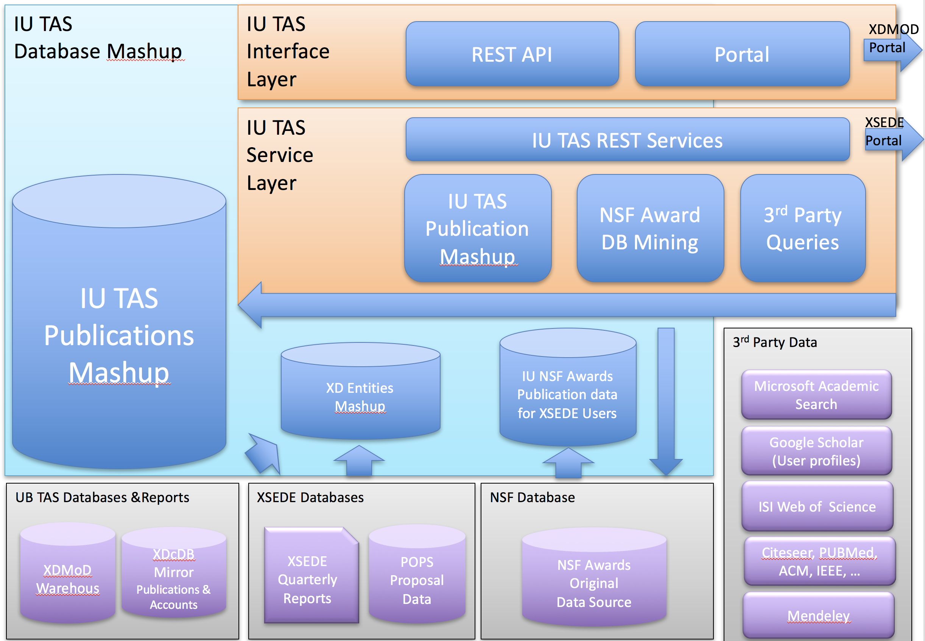
Integration with XDMoD
Scientific Impact analysis available through tab in XDMoD

Slide 8
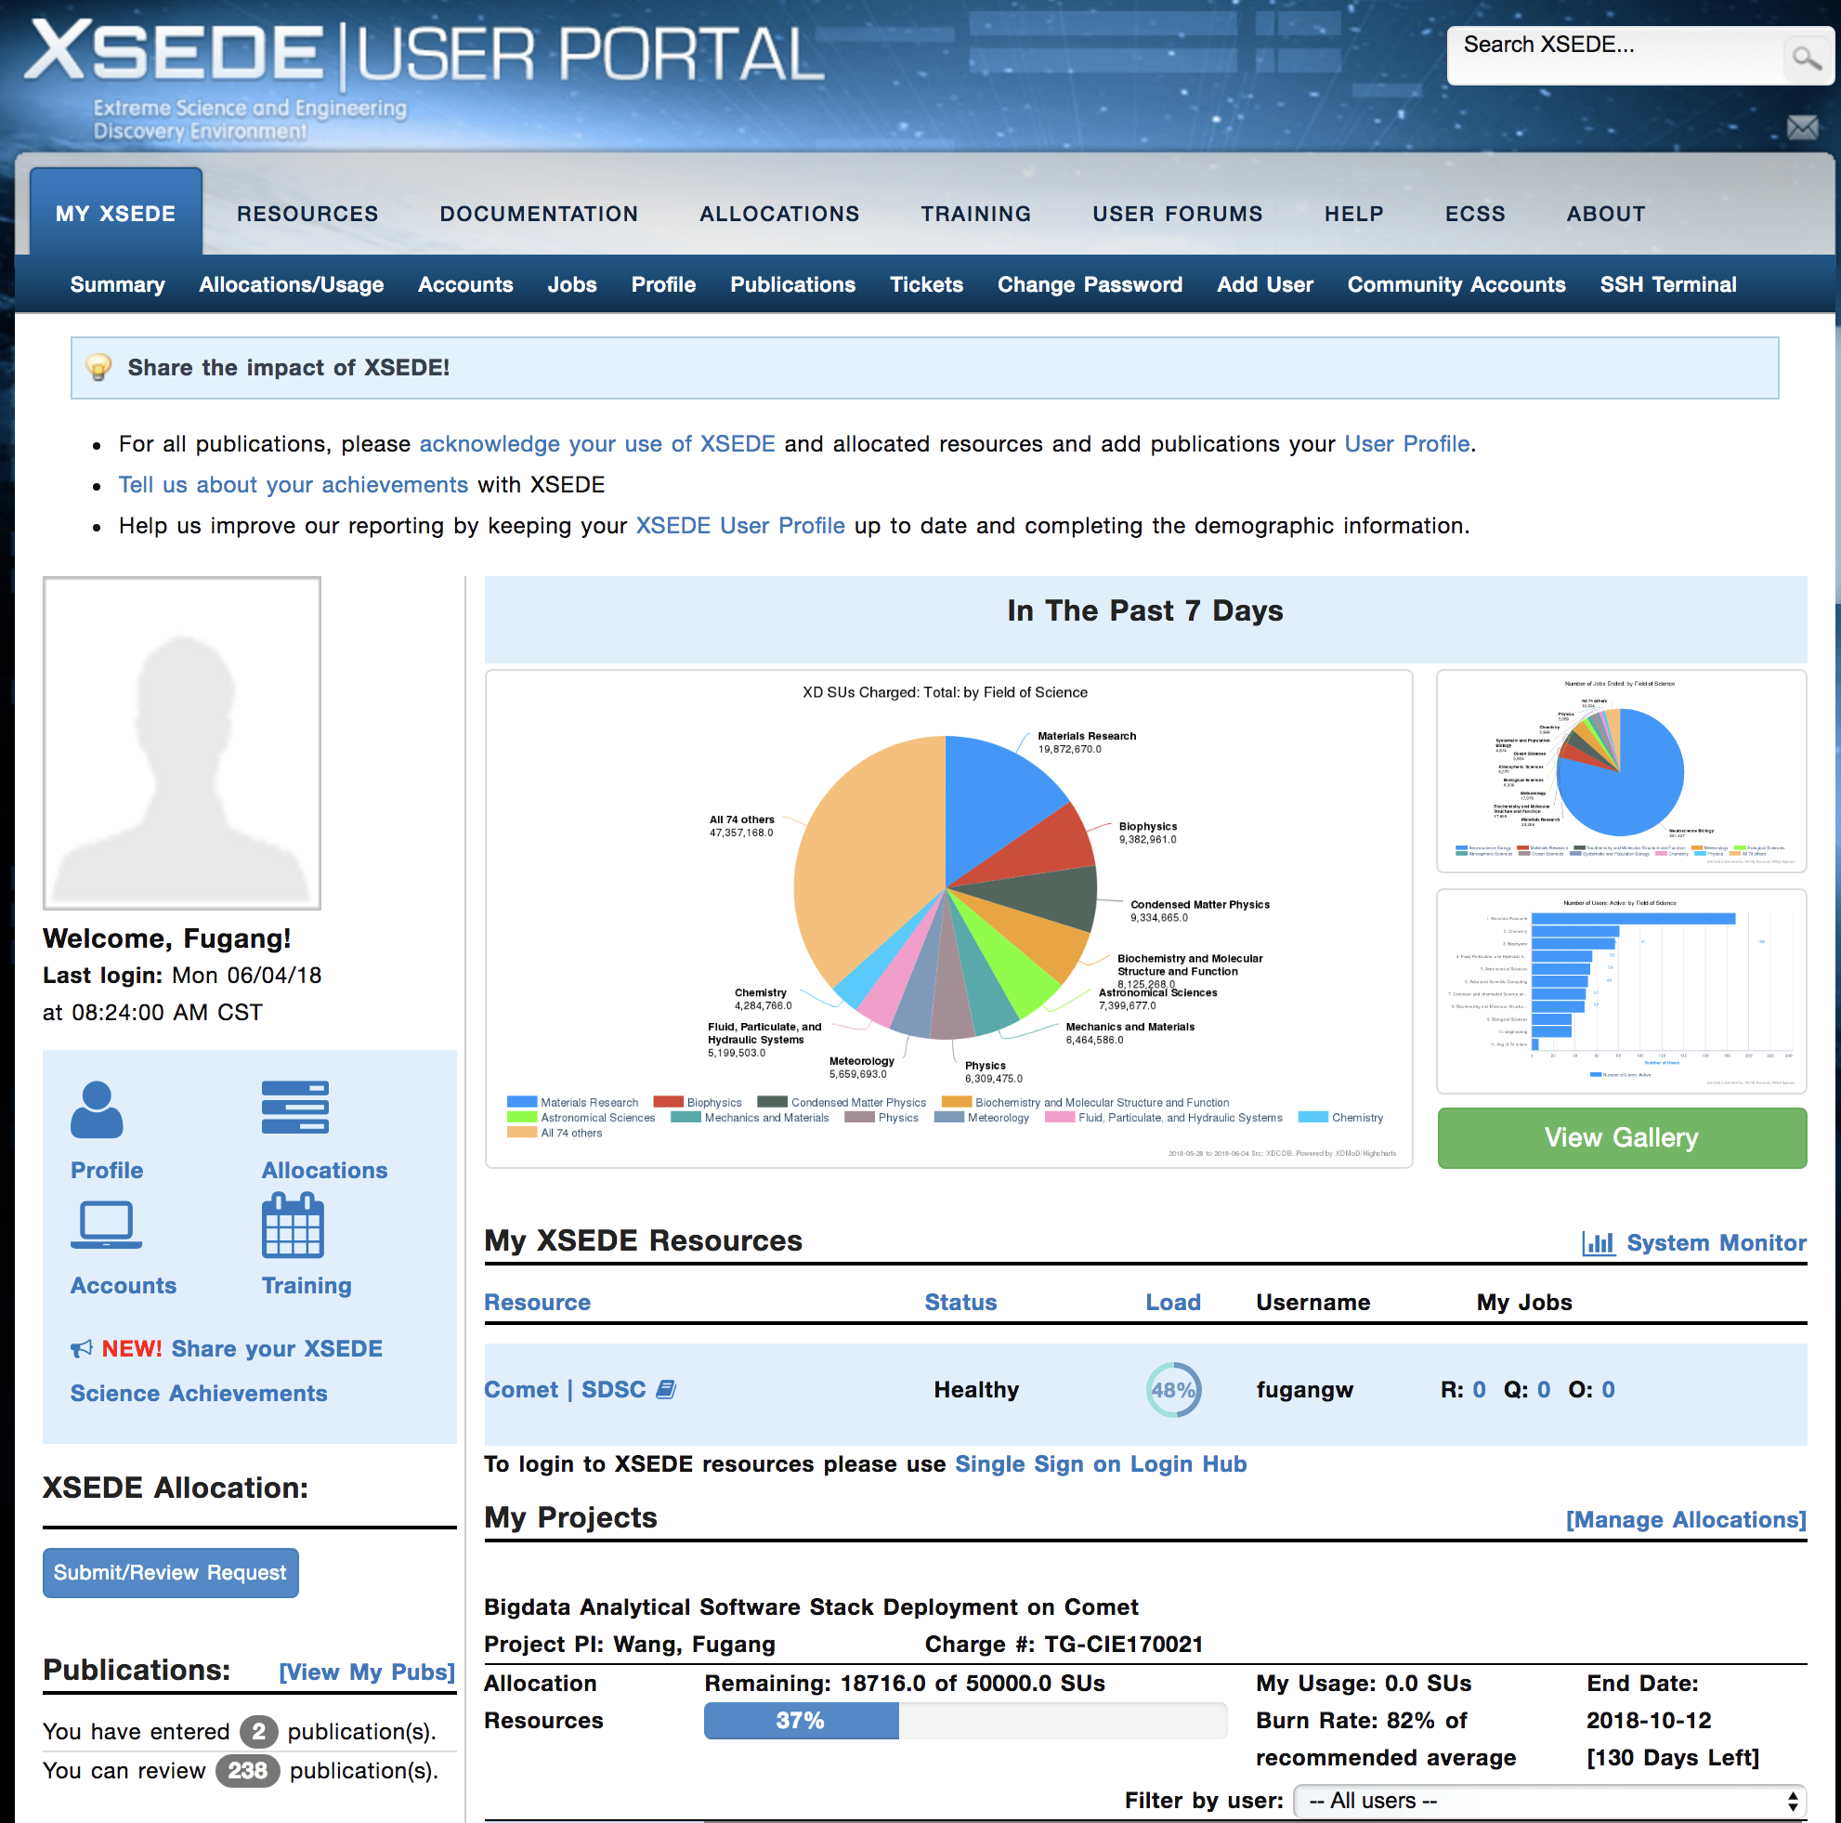
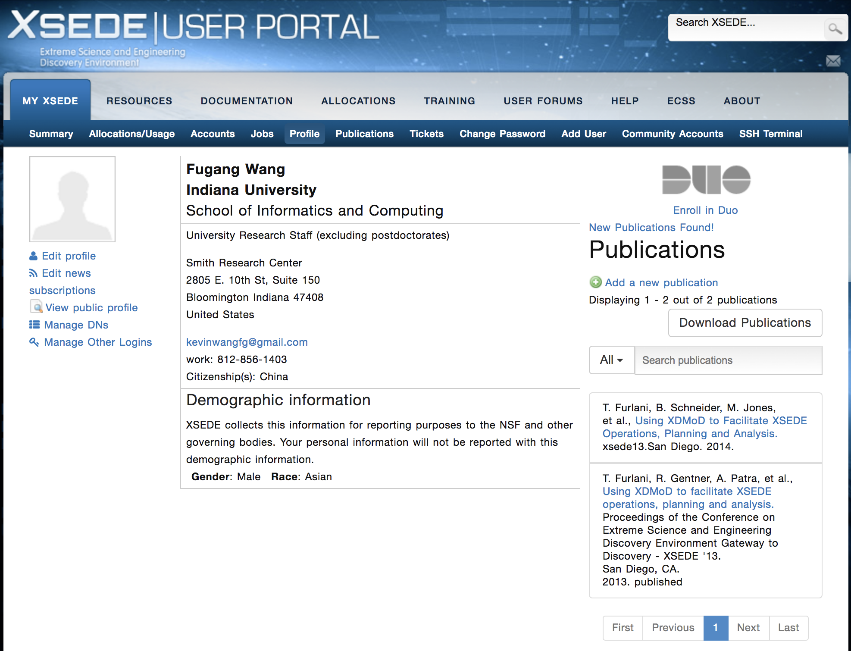
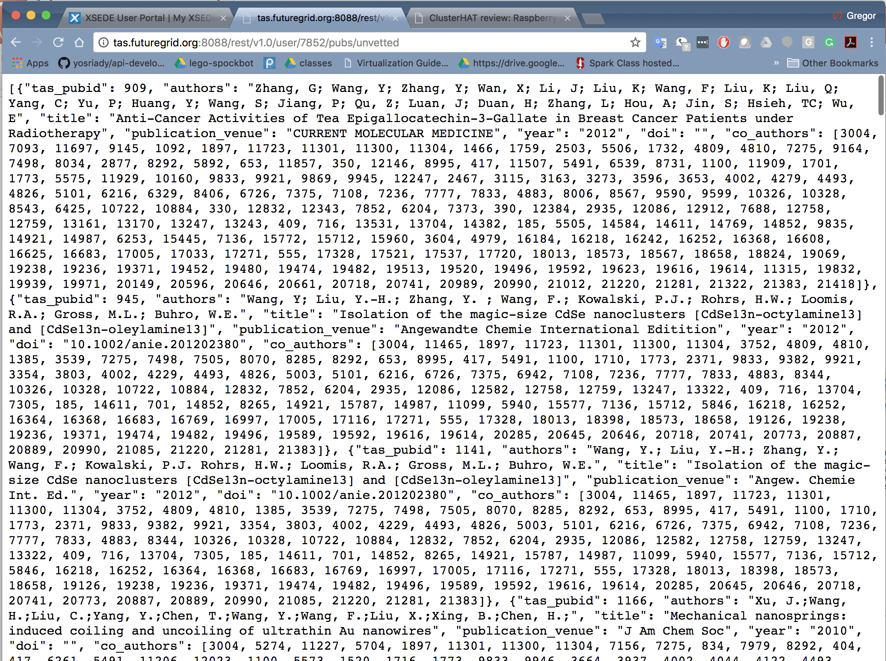
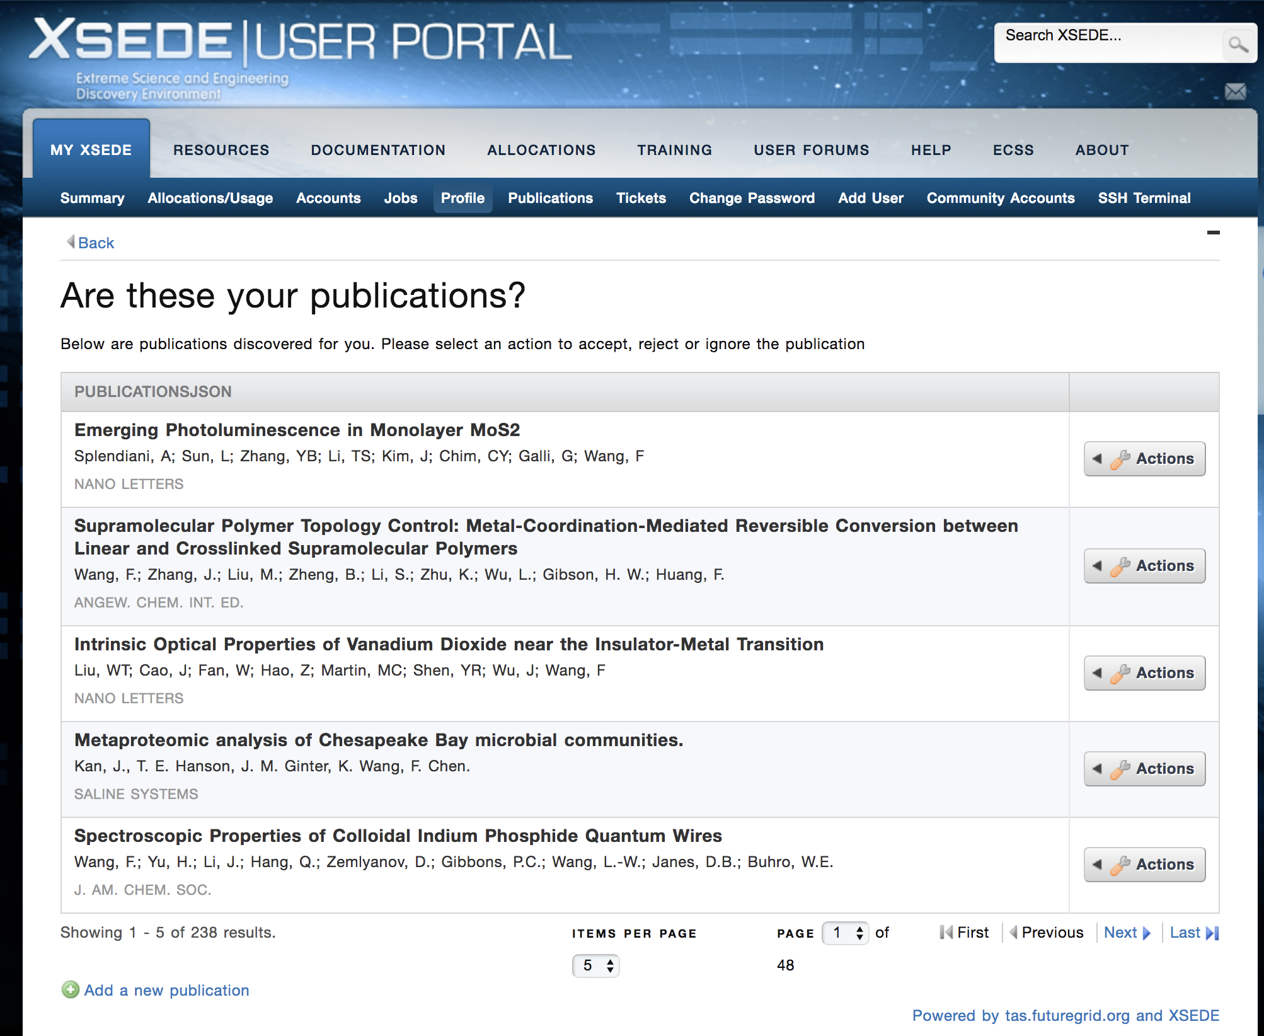
REST Service Integration to XUP
Others could leverage our service

Slide 9
XSEDE Publication Discovery Service
ISE IU Cleanup
ISE IU Curated Publication Data
60 Million Entries
XSEDE
Publication in Central Database
1 Million Publications from
NSF
Awards
Search
ISE IU REST SERVICE
20,000 Publications from past TeraGrid and XSEDE Reports to NSF
15,000 Publications from XUP
XSEDE User Vets Suggested Publications Discovered
Volumes are not depicted in scale
Notes:
An explanation of the previous slide about publication discovery service presented via XUP and powered by our XMS scientific impact analysis effort.

Slide 10
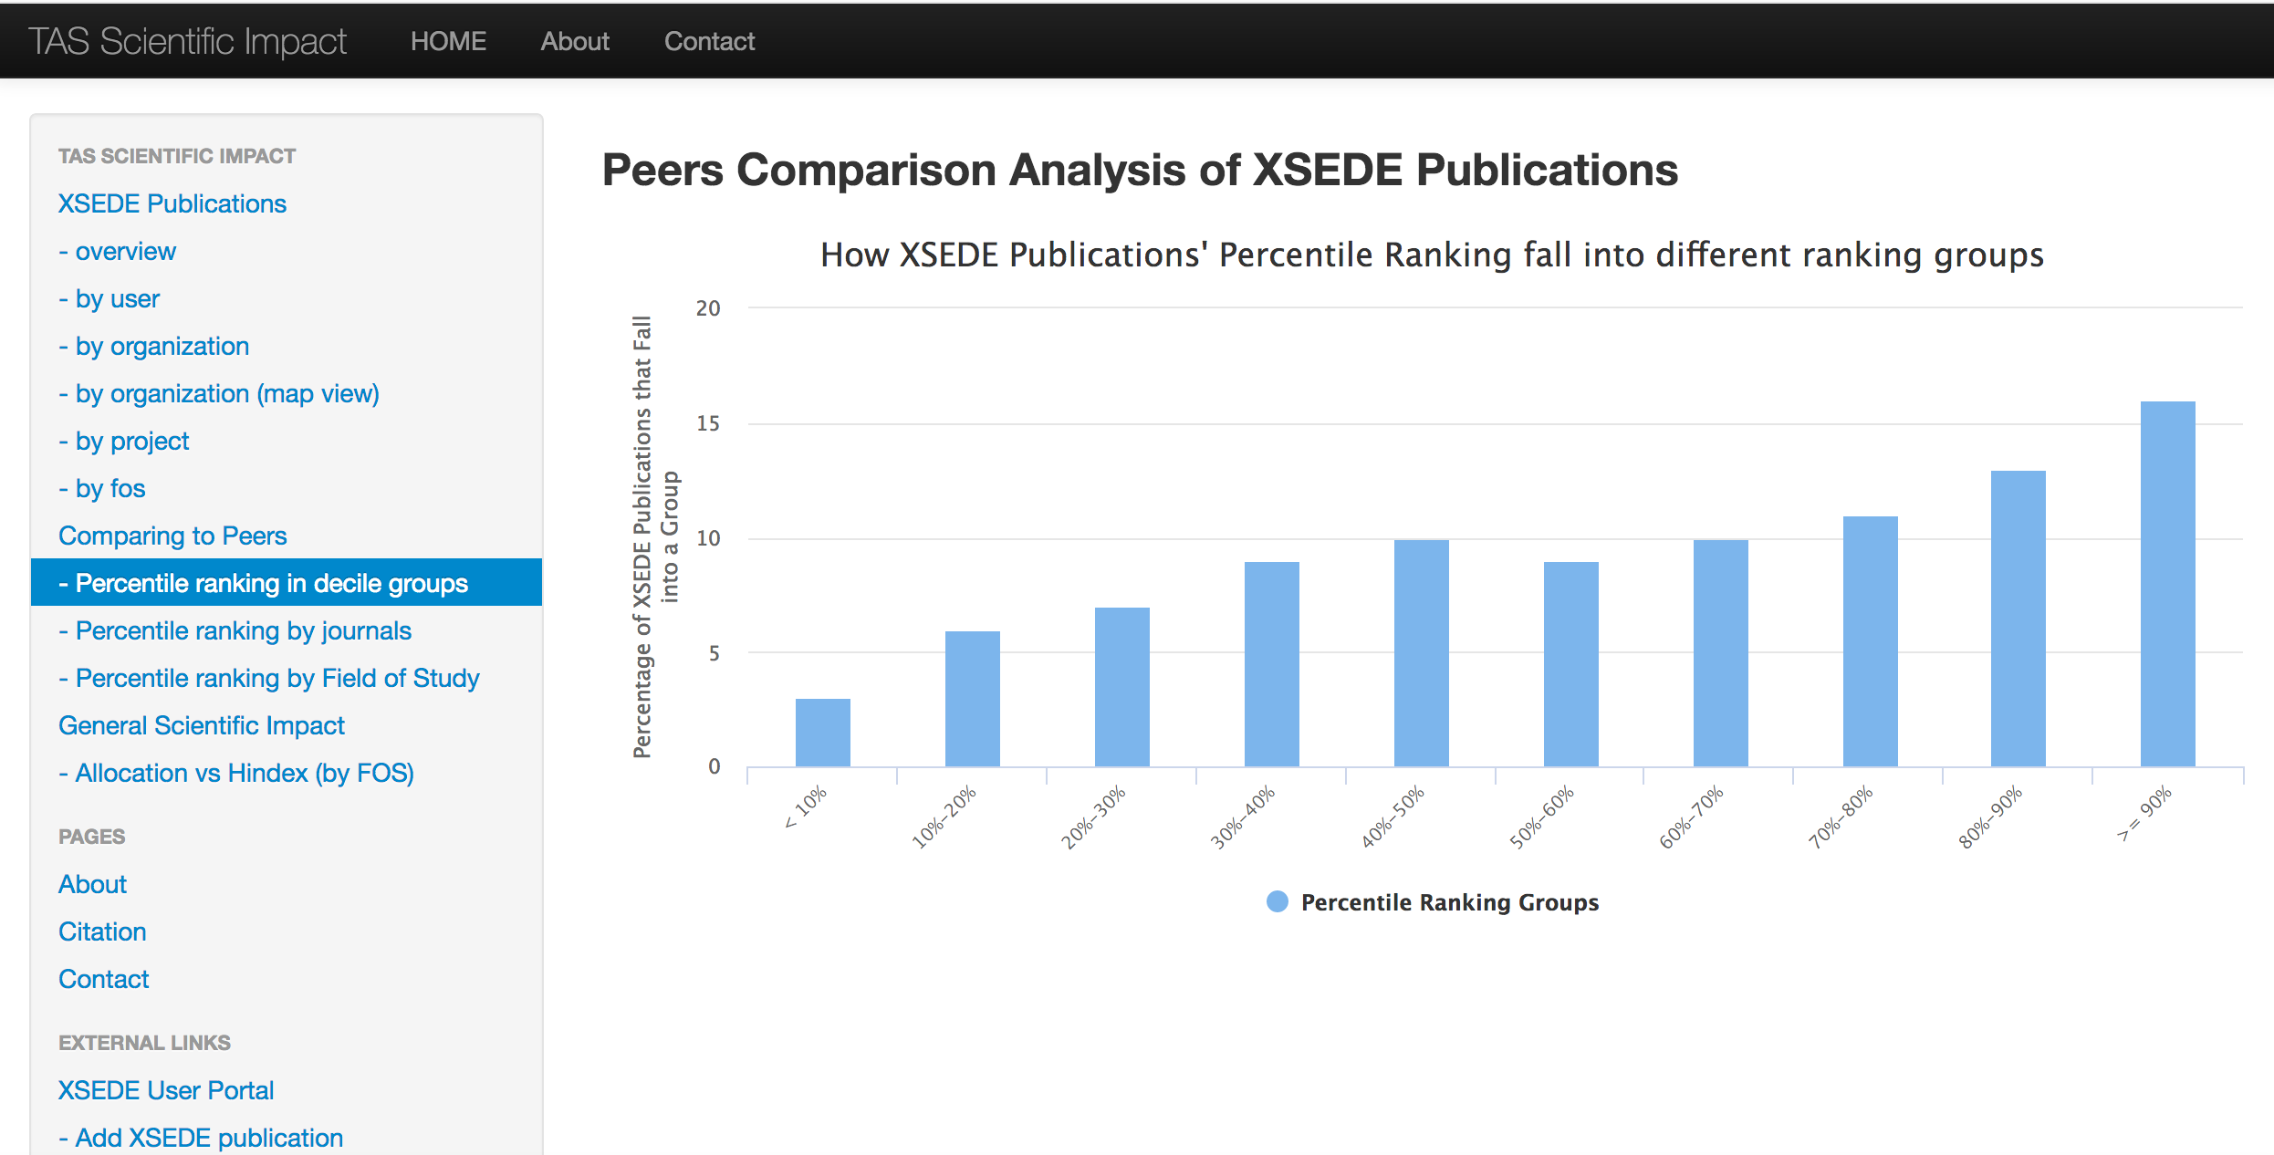
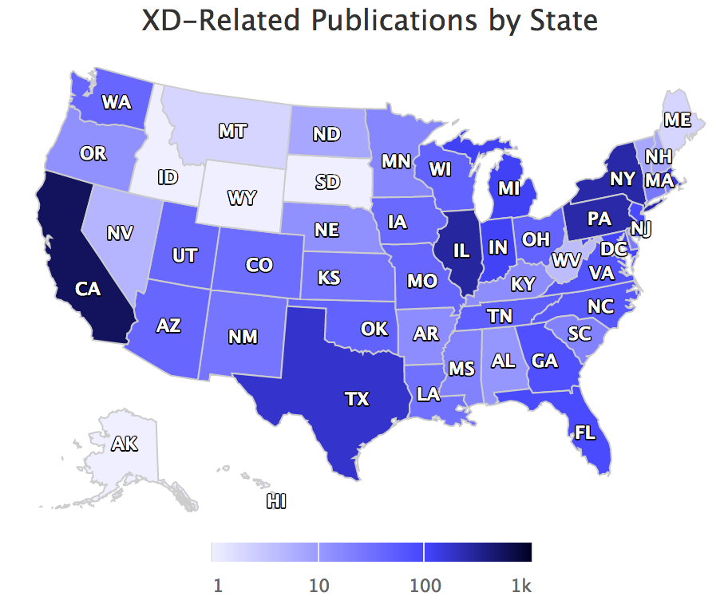
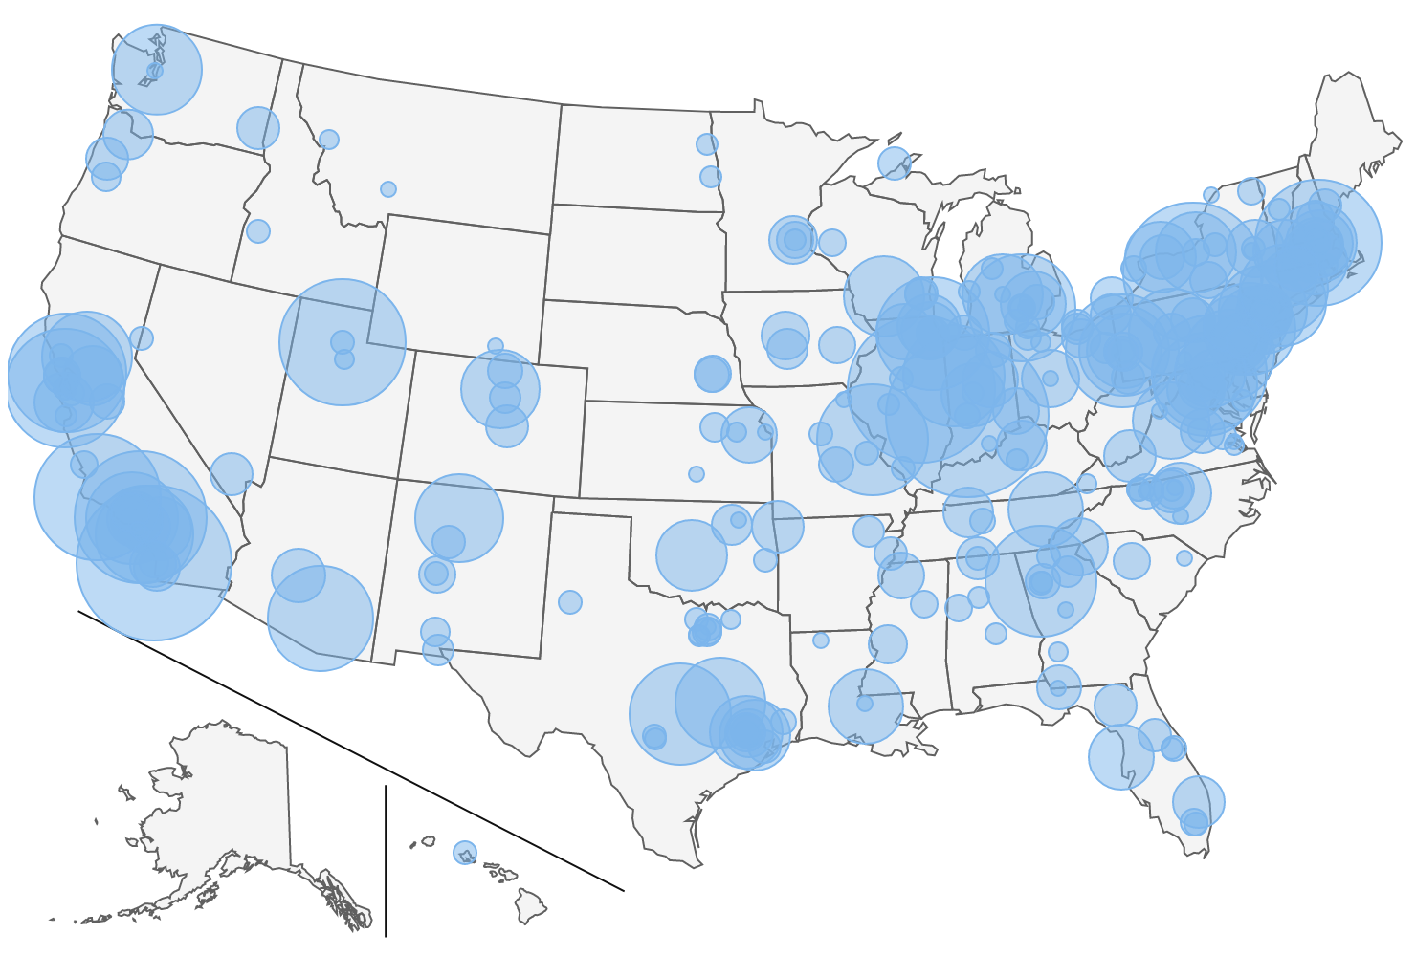
Scientific Impact portal showing the impact metrics
E.g., publication/citation count by Field of Study, by Organization, by Geographical locations
https://sciimp.ccr.xdmod.org/xdportalpub/overview
Notes:
Scientific Impact portal hosted at XDMOD

Slide 11
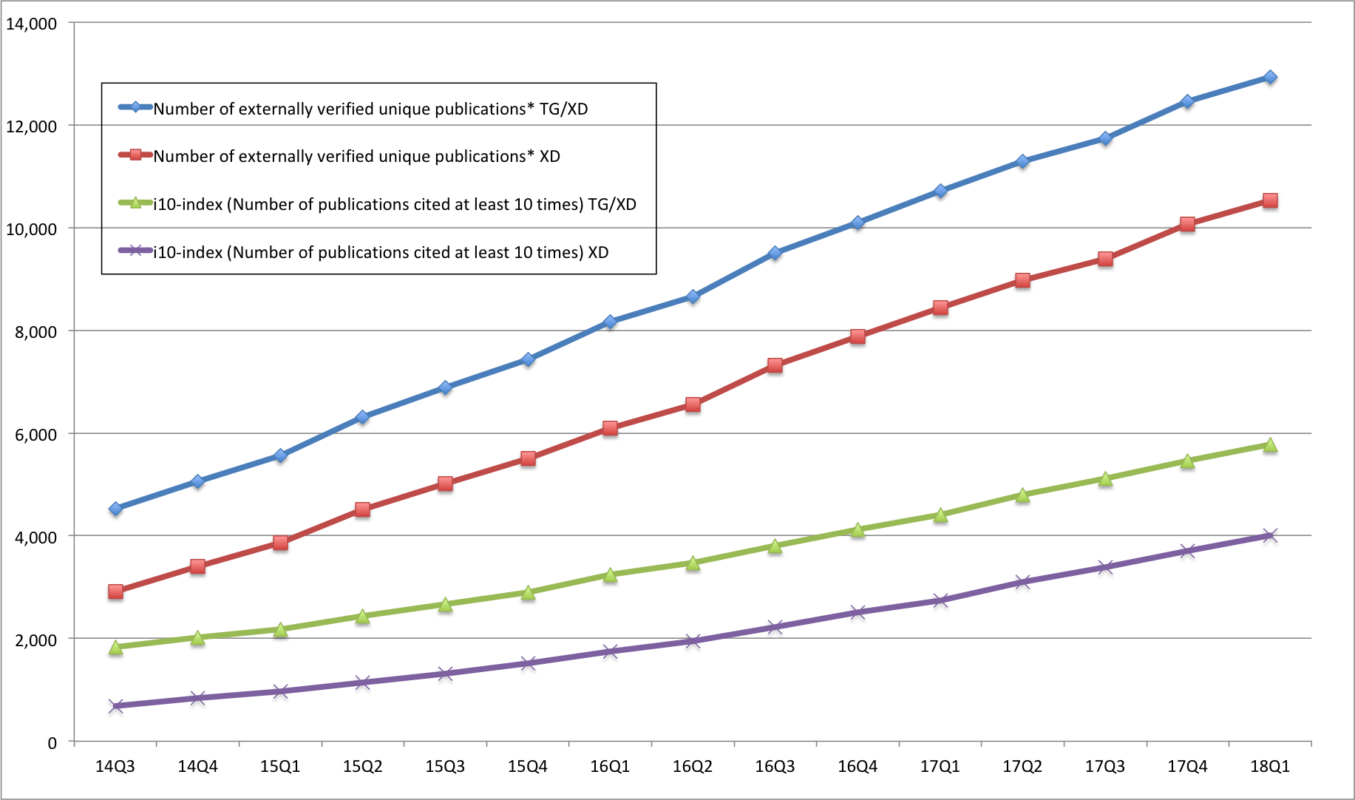
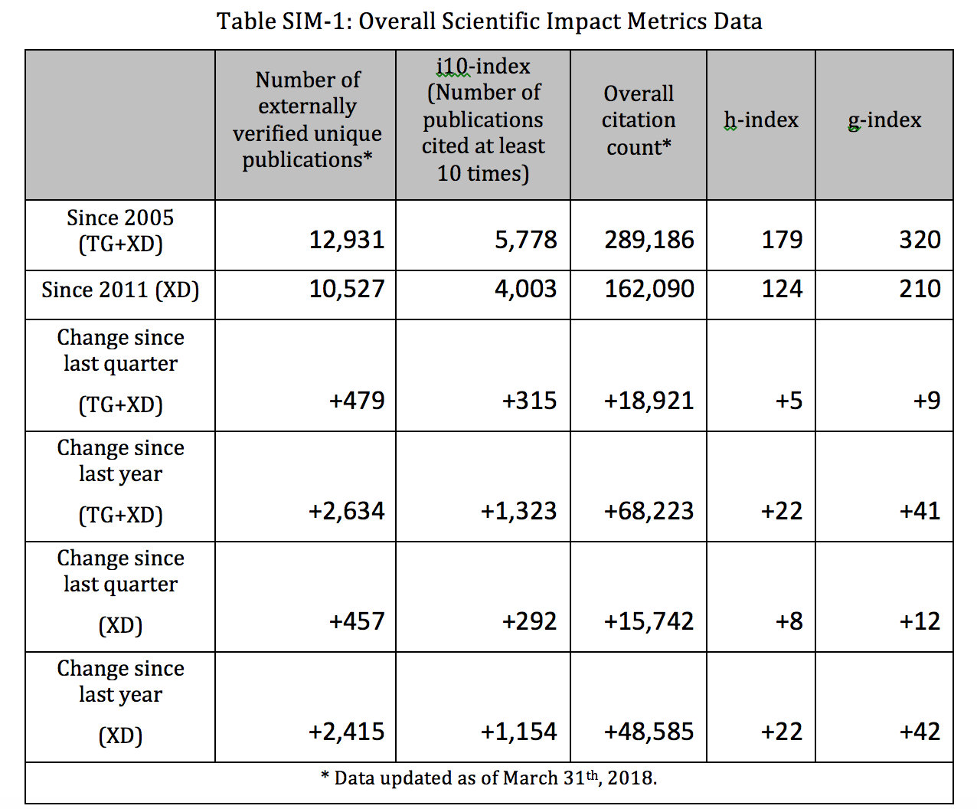
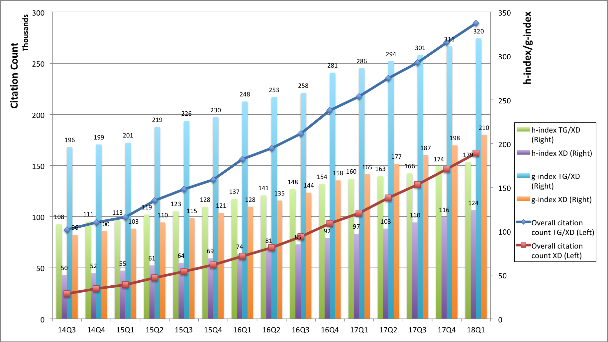
Automated Quarterly report as an appendix for XSEDE NSF report
Monthly updated overall scientific impact metrics
Historical trends of the metrics
Notes:
Monthly data update and quarterly report

Slide 12
Recent Activities

Slide 13
Journal Publication Based Peers Comparison - Introduction
We compare the XSEDE publications to their peers that were published in the same journal issue.
We calculate the percentile rank of the citation count of the publications.
50% means a paper ranked just in the middle based on the citations received.
80% means the paper’s citation count is more than 80% of the papers published in the same journal issue.

Slide 14
Journal Publication Based Peers Comparison - Process
XSEDE publications to be compared
User submitted data from XUP
Parsed from Past TG/XD Quarterly Reports
Verified with external source (ISI Web of Knowledge)
~9k confirmed publications and ~5k in compared groups (from 122 journals that had at least 10 XD publications appeared in them)
Identify Peers
Given one XSEDE/SP publication, we need to identify all the publications that appeared in the same journal issue
Obtained more than 2M publications from the journals that XSEDE/SP publications appeared (source: Web of Science)
Parsed the data and grouped into comparison groups
Calculate percentile rank of citation count for each XD publication within the journal issue it appeared on
Largest know database for comparison for XSEDE publications
Notes:
Identify valid XSEDE publications;
Identify peers;
Calculating percentile rank among comparing groups

Slide 15
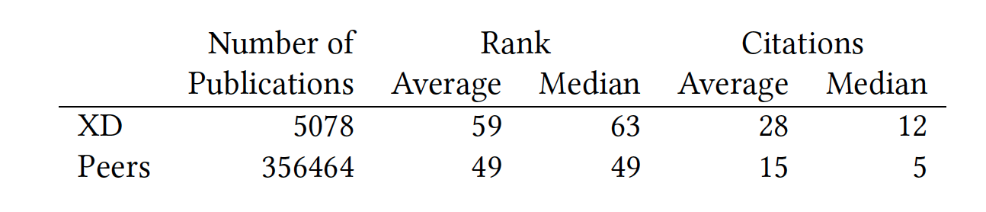
Peers Comparison Summary Statistics
Nonparametric analysis showing difference of sample
Mann-Whitney-Wilcoxon test, Mood’s median test, and Kruskal-Wallis test.
T-test showing quantitative difference (Both statistically significant difference)
Citation count. 95% confidence interval: [10.90,16.32]
Percentile ranking. 95% confidence interval: [9.07,10.59]
Notes:
Nonparametric for qualitative analysis – XD sample and peers sample different
T-test showing quantitative difference with statistically significance
Average XSEDE paper received 10.90-16.32 citations more than their peers;
Average XSEDE paper’s citation ranked 9.07%-10.59% higher than their peers.

Slide 16
Histogram of Percentile Ranking, in Decile Groups
Notes:
Percentile rank scores in each 10% groups.
More on higher end.

Slide 17
Peers Comparison by Journal
Average percentile ranking data grouped by journal name
Purple horizontal line indicates the 50% percentile
GREEN bars greater than 50% and RED less than 50%
XSEDE publications in most journals tend to receive more citation than their peers do.
Analysis using median instead of average show similar results. Aggregating by FOS showing similar results as well (more graph on reports and paper).
Notes:
Peers comparison data grouped by journal names
Average data
Green > 50%, better half
Red < 50%, below average

Slide 18
Peers Comparison for Publications - Discussion
Overall percentile ranking scores skewed on the higher end (the histogram graph)
With 95% confidence level (from T-test):
Average XSEDE paper receives 10.90-16.32 citations more than their peers
Average XSEDE paper ranks 9.07%-10.59% higher than their peers judging by citations received
peers meaning in the same journal issue
While grouping by each journal, results shows that XSEDE publications in most journals tend to receive more citation than their peers do.
Notes:
In general GOOD
FOS difference. Most good, some below average

Slide 19
Fields Weighted Citation Impact (FWCI)
Introduced as part of the snowball metrics (https://www.snowballmetrics.com/)
Definition: The ratio of the average citation of XSEDE publications to that of ALL the publications in the same Field of Study
FWCI value 1: Received citations as expected
FWCI value > 1: Received more than expected citations
FWCI value < 1: Received less than expected citations
E.g., a FWCI value 2.5 means the studied group received 1.5 times more citations than expected

Slide 20
Field and FWCI by Publication Count
Notes:
Data point values – FWCI (XD publication number/publication number in the field)
Sorted by publication count of field to emphasize the impact of the FOS more tightly related to XD
Most above 1 (better than expected) – political science below, but only 3 data points thus not statistically significant
Overall 4.3 pretty high. 4.3 times the average from ALL, or 3.3 times more than expected

Slide 21
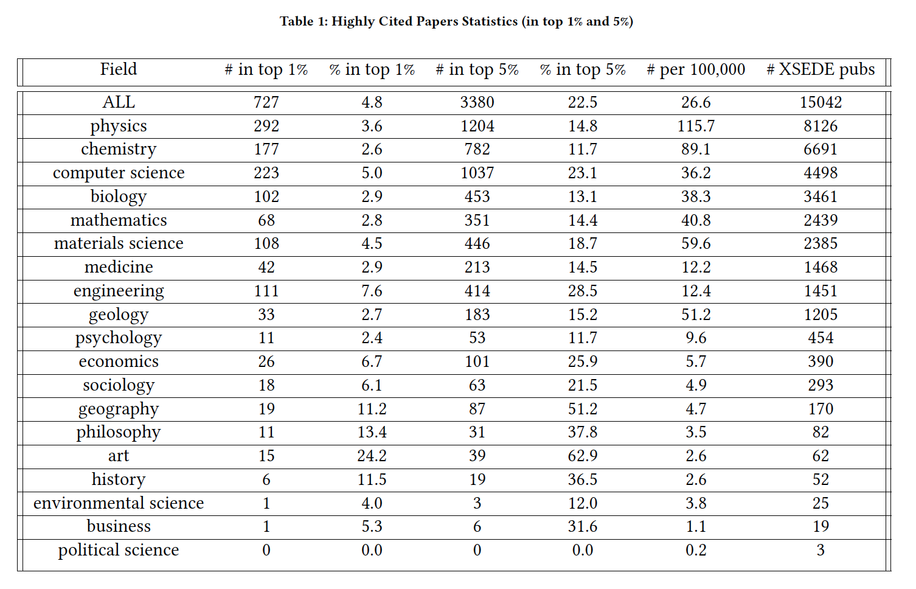
Highly Cited Papers
Notes:
How many, and in what percentage, of XD papers fall into the highly cited papers group?
Overall, 4.8% XD papers in top 1% highly cited group; 22.5% in top 5%. Out of proportionally good.
Again, XD papers more on the higher end.

Slide 22
Publications
Fugang Wang, Gregor von Laszewski, Timothy Whitson, Geoffrey C. Fox, Thomas R. Furlani, Robert L. DeLeon, and Steven M. Gallo. 2018. Evaluating the Scientific Impact of XSEDE. In PEARC ’18: Practice and Experience in Advanced Research Computing, July 22–26, 2018, Pittsburgh, PA, USA. ACM, New York, NY, USA, 8 pages. https://doi.org/10.1145/3219104.3219124
Gregor von Laszewski, Fugang Wang, Geoffrey C. Fox, David L. Hart, Thomas R. Furlani, Robert L. DeLeon, Steven M. Gallo, Peer Comparison of XSEDE and NCAR Publication Data. Cluster Computing (CLUSTER) 2015 IEEE International Conference on, pp. 531-532, 2015. doi:10.1109/CLUSTER.2015.98.
Fugang Wang, Gregor von Laszewski, Geoffrey C. Fox, Thomas R. Furlani, Robert L. DeLeon, and Steven M. Gallo. Towards a scientific impact measuring framework for large computing facilities - a case study on xsede. In Proceedings of the 2014 Annual Conference on Extreme Science and Engineering Discovery Environment, XSEDE ’14, pages 25:1–25:8, New York, NY, USA, 2014. ACM. URL: http://doi.acm.org/10.1145/2616498.2616507, doi:10.1145/2616498.2616507.

Slide 23
Future Plans
Maintaining the software and workflow to continue providing updated metrics and analysis results for XSEDE.
With the data availability, e.g., publications associated with XSEDE resource being used, providing analysis on that level.
Correlating the output (scientific impact gained) to the input (Funding amount; XSEDE Resources being used; etc.) to further extend the ROI model and analysis.
Applications beyond XSEDE. Utilizing our software and analysis workflow to provide similar metrics and impact analysis for similar organizations or virtual organizations.

Slide 24
Conclusions
We developed software stack and workflow to collect and curate publication and citation data from various sources and put into mashup database.
Statistical analysis showing XD produced papers tend to receive more citations (comparing to papers in the same fields via FWCI analysis; comparing to peers in the same journal issues).
Scientific Impact web portal to display the various metrics and analyses results.
RESTful service utilized by XUP for publication discovery.
Monthly data update and quarterly scientific impact appendix to XSEDE report to NSF.
Value is increasing through continuation of effort over long period of time

